Slide 1
Chapter 5: CPU Scheduling

Slide 2
Chapter Objectives
To introduce CPU scheduling, which is the basis for multi-programmed operating systems.
To describe various CPU-scheduling algorithms.
To discuss evaluation criteria for selecting a CPU-scheduling algorithm for a particular system.

Slide 3
Content Overview
Basic Concepts
Scheduling Criteria
Scheduling Algorithms
Multiple-Processor Scheduling
Thread Scheduling
Operating Systems Examples
Algorithm Evaluation

Slide 4
5.1 Basic Concepts
Maximum CPU utilization obtained with multiprogramming
In a single-processor system, only one process can run at a time; any others must wait until the CPU is free and can be rescheduled. The objective of multiprogramming is to have some process running at all times.
A process is executed until it must wait, typically for the completion of some I/O request. In a simple computer system, the CPU then just sits idle. All this waiting time is wasted; With multiprogramming, several processes are kept in memory at one time. When one process has to wait, the operating system takes the CPU away from that process and gives the CPU to another process. This pattern continues. Every time one process has to wait, another process can take over use of the CPU.

Slide 5
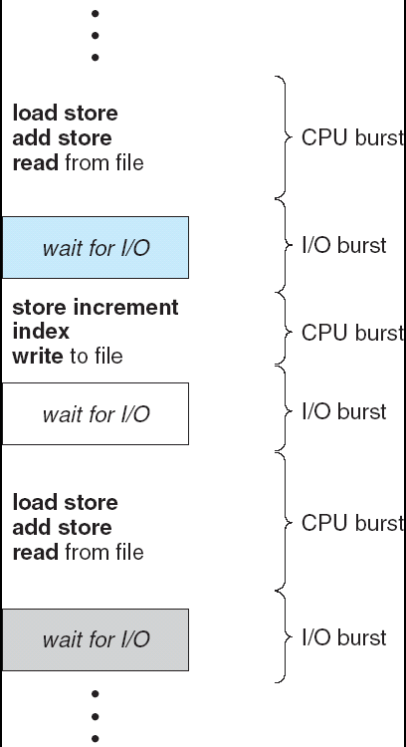
Alternating Sequence of CPU And I/O Bursts
Maximum CPU utilization obtained with multiprogramming
CPU–I/O Burst Cycle – Process execution consists of a cycle of CPU execution and I/O wait
CPU burst followed by I/O burst
CPU burst distribution is of main concern

Slide 6
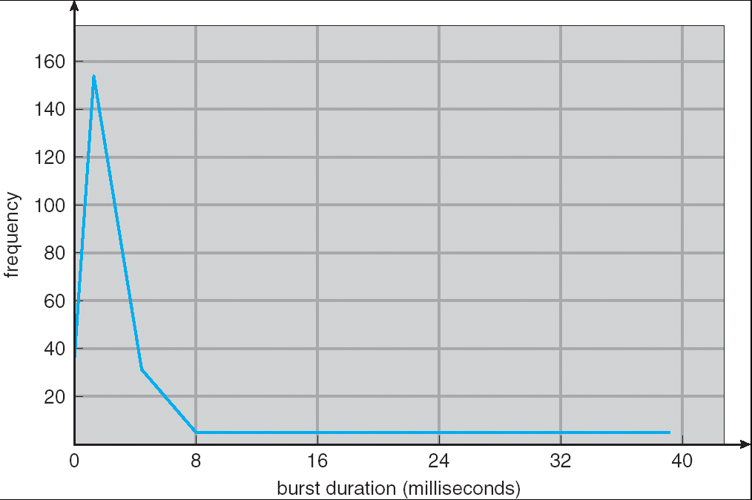
Histogram of CPU-burst Times

Slide 7
CPU Scheduler
Selects from among the processes in memory that are ready to execute, and allocates the CPU to one of them
CPU scheduling decisions may take place when a process:
1. Switches from running to waiting state
2. Switches from running to ready state
3. Switches from waiting to ready
4. Terminates
Scheduling under 1 and 4 is nonpreemptive(非抢占) or cooperative(协作)
All other scheduling is preemptive(抢占)

Slide 8
Preemptive and Nonpreemptive
指占用CPU的方式
可抢占式Preemptive（可剥夺式）
当有比正在运行的进程优先级更高的进程就绪时，系统可强行剥夺正在运行进程的CPU，提供给具有更高优先级的进程使用。现代的主流OS均为抢占式
不可抢占式Non-preemptive（不可剥夺式 ）
某一进程被调度运行后，除非由于它自身的原因不能运行，否则一直运行下去

Slide 9
Preemptive Scheduling and Race Conditions
Preemptive scheduling can result in race conditions(竞争条件 or 竞态条件) when data are shared among several processes.
Consider the case of two processes that share data. While one process is updating the data, it is preempted so that the second process can run. The second process then tries to read the data, which are in an inconsistent state.
This issue will be explored in detail in Chapter 6.

Slide 10
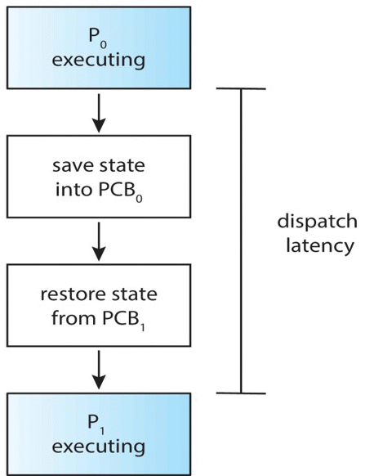
Dispatcher
Dispatcher module gives control of the CPU to the process selected by the short-term scheduler; this involves:
switching context
switching to user mode
jumping to the proper location in the user program to restart that program
Dispatch latency – time it takes for the dispatcher to stop one process and start another running

Slide 11
5.2 Scheduling Criteria(调度准则)
CPU utilization(CPU利用率) – keep the CPU as busy as possible
Throughput(吞吐量) – # of processes that complete their execution per time unit
Turnaround time(周转时间) – amount of time to execute a particular process
Waiting time(等待时间) – amount of time a process has been waiting in the ready queue
Response time(响应时间) – amount of time it takes from when a request was submitted until the first response is produced, not output (for time-sharing environment)

Slide 12
Optimization Criteria
Max CPU utilization
Max throughput
Min turnaround time
Min waiting time
Min response time

Slide 13
5.3 Scheduling Algorithms
First-Come, First-Served (FCFS) 先到先服务
Shortest-Job-First (SJF) 最短作业优先
Shortest-Remaining-Time-First (SRTF) 最短剩余时间优先
Highest Response Ratio Next (HRRN) 最高响应比优先
Priority Scheduling 优先级调度
Round Robin (RR) 轮转法调度
Multilevel Queue Scheduling 多级队列调度
Multilevel Feedback Queue Scheduling 多级反馈队列调度

Slide 14
First-Come, First-Served (FCFS) Scheduling
Process Burst Time
P₁ 24
P₂ 3
P₃ 3
Suppose that the processes arrive in the order: P₁ , P₂ , P₃ The Gantt Chart for the schedule is:
Waiting time for P₁ = 0; P₂ = 24; P₃ = 27
Average waiting time: (0 + 24 + 27) / 3 = 17
Turnaround time P₁ = 24; P₂ = 27; P₃ = 30
Average turnaround time: (24 + 27 + 30) / 3 = 27
P₁
P₂
P₃
0
24
27
30
Notes:
本教材中，最关心的是平均等待时间的比较

Slide 15
FCFS Scheduling (Cont.)
Suppose that the processes arrive in the order
P₂ , P₃ , P₁
The Gantt chart for the schedule is:
Waiting time for P₁ = 6; P₂ = 0; P₃ = 3
Average waiting time: (6 + 0 + 3) / 3 = 3
Much better than previous case
Nonpreemptive
Convoy effect(护航效果) short process behind long process
Consider one CPU-bound and many I/O-bound processes
P₂
P₃
P₁
0
3
6
30
Notes:
Convoy effect(护航效果) ：众多短CPU周期的进程，等待一个长CPU周期的进程完成当前CPU周期。与让较短进程最先执行相比，会让CPU及设备利用率变得更低

Slide 16
Convoy Effect(护航效果)
Assume we have one CPU-bound process and many I/O-bound processes. As the processes flow around the system, the following scenario may result. The CPU-bound process will get and hold the CPU. During this time, all the other processes will finish their I/O and will move into the ready queue, waiting for the CPU. While the processes wait in the ready queue, the I/O devices are idle. Eventually, the CPU-bound process finishes its CPU burst and moves to an I/O device. All the I/O-bound processes, which have short CPU bursts, execute quickly and move back to the I/O queues. At this point, the CPU sits idle. The CPU-bound process will then move back to the ready queue and be allocated the CPU. Again, all the I/O processes end up waiting in the ready queue until the CPU-bound process is done. There is a convoy effect as all the other processeswait for the one big process to get off the CPU. This effect results in lower CPU and device utilization than might be possible if the shorter processeswere allowed to go first.

Slide 17
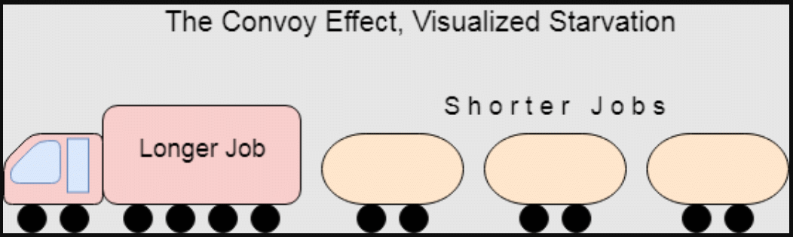
Convoy Effect(护航效果)
FCFS的护航效果是指，若干个具有short cpu burst特性的小进程，会被迫跟在一个具有long cpu burst特性的大进程之后，很长时间才获得一次cpu执行机会，而这些小进程本身cpu burst又很短(因为要频繁做I/O)，好不容易获得一次cpu执行机会，很快就被迫放弃cpu进入wait队列了，因此进程推进缓慢

Slide 18
Shortest-Job-First (SJF) Scheduling
Associate with each process the length of its next CPU burst. Use these lengths to schedule the process with the shortest time(最短作业优先调度)
Shortest-next-CPU-burst algorithm
Two schemes:
nonpreemptive – once CPU given to the process it cannot be preempted until completes its CPU burst
preemptive – if a new process arrives with CPU burst length less than remaining time of current executing process, preempt. This scheme is know as the Shortest-Remaining-Time-First (SRTF，最短剩余时间调度)，also called Shortest-Remaining-Time-Next (SRTN)
SJF is provably optimal – gives minimum average waiting time for a given set of processes
The difficulty is knowing the length of the next CPU request

Slide 19
Example of Non-Preemptive SJF
Process Arrival Time Burst Time
P₁ 0.0 7
P₂ 2.0 4
P₃ 4.0 1
P₄ 5.0 4
SJF (non-preemptive)
Average waiting time = (0 + (8 – 2) + (7 - 4) + (12 – 5)) / 4 = 4
P₁
P₃
P₂
P₄
0
3
7
8
12
16

Slide 20
Example of Preemptive SJF
Process Arrival Time Burst Time
P₁ 0.0 7
P₂ 2.0 4
P₃ 4.0 1
P₄ 5.0 4
SJF (preemptive)
Average waiting time = ((11 – 2) + (5 – 4) + 0 + (7 – 5)) / 4 = 3
P₁
P₂
P₃
P₂
P₄
P₁
0
2
4
5
7
11
16

Slide 21

Determining Length of Next CPU Burst
Can only estimate the length
Can be done by using the length of previous CPU bursts, using exponential averaging
$$τ_{n+1}=α t_{n}+\left(1−α\right)τ_{n}$$

Slide 22
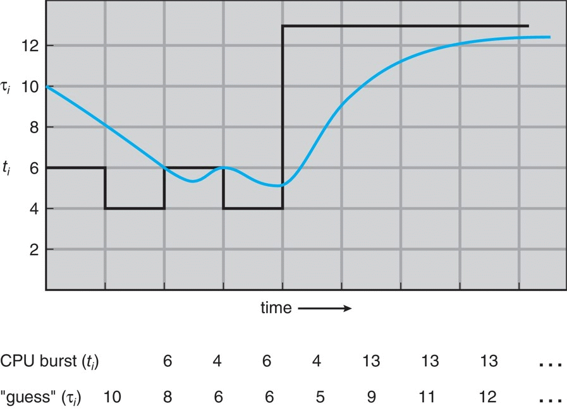
Prediction of the Length of the Next CPU Burst

Slide 23
Examples of Exponential Averaging
α = 0
τ_{n+1} = τ_{n}
Recent history does not count
α = 1
τ_{n+1} = t_{n}
Only the actual last CPU burst counts
If we expand the formula, we get:
τ_{n+1} = α t_{n} + (1 - α)α t_{n-1} + …
+ (1 - α )^{j} α t_{n-j} + …
+ (1 - α )^{n +1} τ₀
Since both α and (1 - α) are less than or equal to 1, each successive term has less weight than its predecessor

Slide 24
Highest Response Ratio Next
最高响应比优先(HRRN) Ref. William Stallings; 汤小丹
FCFS仅考虑作业的等待时间
SJF仅考虑作业的运行时间
HRRN综合考虑两者。调度时，首先计算Ready队列中每个进程的响应比R，并选择R值最高的进程获得CPU执行
响应比R = 周转时间 / 处理时间
=（处理时间 + 等待时间）/ 处理时间
= 1 +（等待时间 / 处理时间）
Notes:
OSC书中无HRRN

Slide 25
Priority Scheduling
A priority number (integer) is associated with each process
The CPU is allocated to the process with the highest priority (smallest integer ≡ highest priority)
Preemptive
Nonpreemptive
SJF is a priority scheduling where priority is the predicted next CPU burst time
Problem ≡ Starvation – low priority processes may never execute
Solution ≡ Aging(老化) – as time progresses, increase the priority of the process

Slide 26
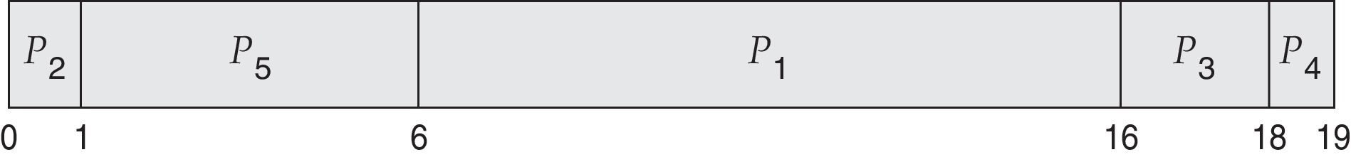
Example of Priority Scheduling
ProcessA arri Burst TimeT Priority
P₁ 10 3
P₂ 1 1 (Highest Priority)
P₃ 2 4
P₄ 1 5 (Lowest Priority)
P₅ 5 2
Priority scheduling Gantt Chart
Average waiting time = (6 + 0 + 16 +18 + 1) / 5 = 8.2

Slide 27
Priorities Definition
Priorities can be defined either internally or externally.
Internally defined priorities use some measurable quantity or quantities to compute the priority of a process. For example, time limits, memory requirements, the number of open files, and the ratio of average I/O burst to average CPU burst have been used in computing priorities.
External priorities are set by criteria outside the operating system, such as the importance of the process, the type and amount of funds being paid for computer use, the department sponsoring the work, and other, often political, factors.

Slide 28
Round Robin (RR，轮转法调度)
Each process gets a small unit of CPU time (time quantum q), usually 10-100 milliseconds. After this time has elapsed, the process is preempted and added to the end of the ready queue.
If there are n processes in the ready queue and the time quantum is q, then each process gets 1/n of the CPU time in chunks of at most q time units at once. No process waits more than (n-1)q time units.
Timer interrupts every quantum to schedule next process
Performance
q large ⇒ FIFO(FCFS)
q small ⇒ q must be large with respect to context switch, otherwise overhead is too high
Notes:
round robin 的词源如下：源自法国，其中 robin 与意为“知更鸟”的 robin 毫无关系。这个 robin 似乎是法语 ruban (缎带，丝带，带子)一词的讹误。在17至18世纪的法国，凡带头在请愿书或抗议书上签名的人几乎总是判以死罪，斩首示众。以后请愿人便不愿在请愿书而在一条带子上签名，并使所有签名呈环状，然后将带子系在请愿书上。签名的先后次序就不会被显露，发起者或带头签名这也就可以少担些风险。这种圆形签名请愿书或抗议书法语叫做 ruban rond ，相当于英语中的 round robin 。

Slide 29
Example of RR with Time Quantum = 20
Process Burst Time
P₁ 53
P₂ 17
P₃ 68
P₄ 24
The Gantt chart is:
Typically, higher average turnaround than SJF, but better response
P₁
P₂
P₃
P₄
P₁
P₃
P₄
P₁
P₃
P₃
0
20
37
57
77
97
117
121
134
154
162

Slide 30
Example of RR with Time Quantum = 20
Time | 0 | 20 | 37 | 57 | 77 | 97 | 117 | 121 | 134 | 154 | 162
P1 | 53 | 33 |  |  | __ | 13 |  | __ | 0
P2 | 17 | __ | 0
P3 | 68 |  | __ | 48 |  | __ | 28 |  | __ | 8_ | 0
P4 | 24 |  |  | __ | 4 |  | __ | 0

Slide 31
单个进程等待时间的一种计算方法
对所有调度算法均有：
单个进程等待时间 = (结束时间 - 到达时间) - 执行时间
(结束时间 - 到达时间) 也就是进程的生命周期。而在生命周期里，要么在运行，要么在等待。因此生命周期减去执行时间，就是等待时间
特别适合于计算单个进程时间片数比较多的情况

Slide 32
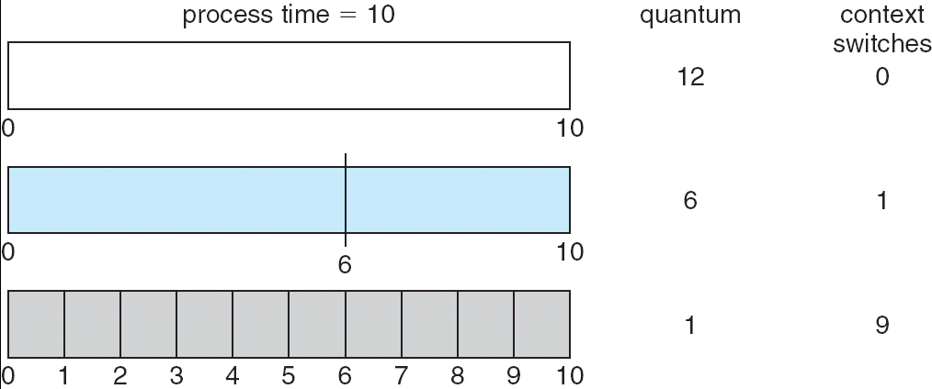
Time Quantum and Context Switch Time

Slide 33
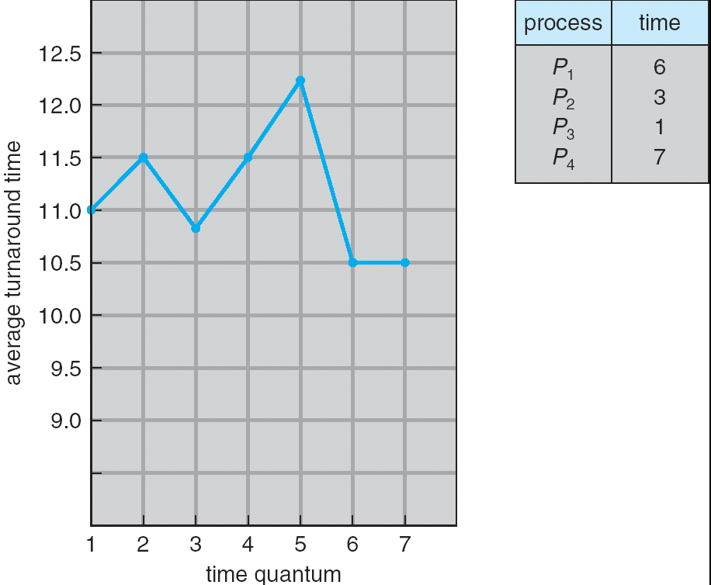
Turnaround Time Varies With The Time Quantum
A rule of thumb is that 80% of the CPU bursts should be shorter than the time quantum.

Slide 34
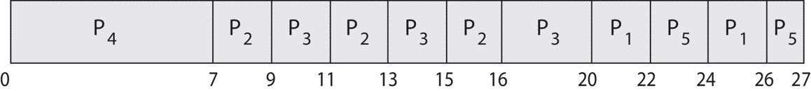
Priority Scheduling w/ Round-Robin
ProcessA arri Burst TimeT Priority
P₁ 4 3
P₂ 5 2
P₃ 8 2
P₄ 7 1
P₅ 3 3
Run the process with the highest priority. Processes with the same priority run round-robin
Gantt Chart with time quantum = 2

Slide 35
Multilevel Queue(多级队列调度)
Ready queue is partitioned into separate queues:
foreground (interactive)
background (batch)
Each queue has its own scheduling algorithm
foreground – RR
background – FCFS
Scheduling must be done between the queues
Fixed priority scheduling; (i.e., serve all from foreground then from background). Possibility of starvation.
Time slice – each queue gets a certain amount of CPU time which it can schedule amongst its processes; i.e., 80% to foreground in RR, 20% to background in FCFS

Slide 36
Multilevel Queue
Each queue has absolute priority over lower-priority queues. No process in the batch queue, for example, could run unless the queues for real-time processes, system processes, and interactive processes were all empty. If an interactive process entered the ready queue while a batch process was running, the batch process would be preempted.
Another possibility is to time-slice among the queues. Here, each queue gets a certain portion of the CPU time,which it can then schedule among its various processes. For instance, in the foreground–background queue example, the foreground queue can be given 80 percent of the CPU time for RR scheduling among its processes, while the background queue receives 20 percent of the CPU to give to its processes on an FCFS basis.

Slide 37
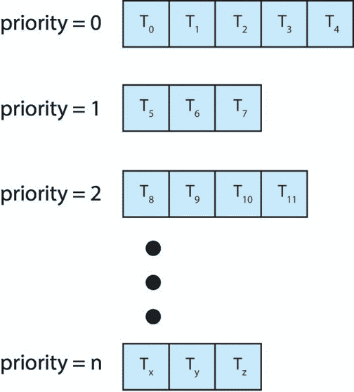
Multilevel Queue
With priority scheduling, have separate queues for each priority.

Slide 38
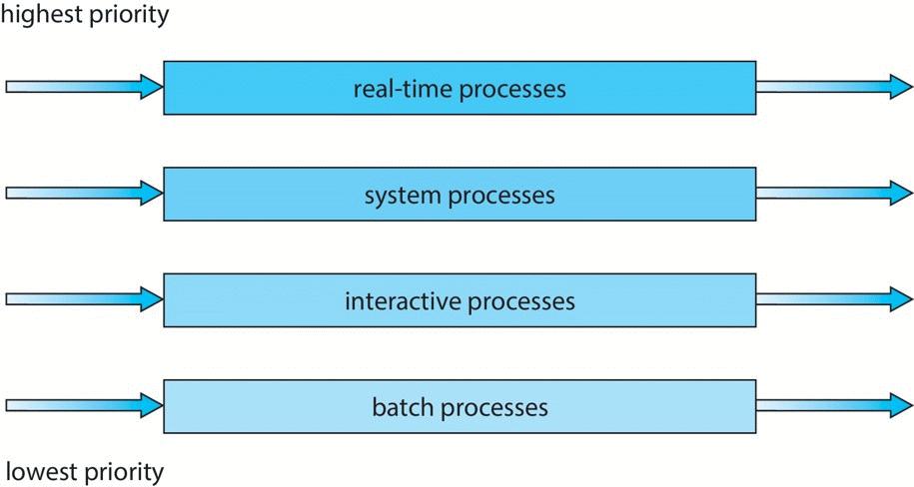
Multilevel Queue Scheduling

Slide 39
Multilevel Feedback Queue
多级反馈队列调度
A process can move between the various queues; aging can be implemented this way
Multilevel-feedback-queue scheduler defined by the following parameters:
number of queues
scheduling algorithms for each queue
method used to determine when to upgrade a process
method used to determine when to demote a process
method used to determine which queue a process will enter when that process needs service

Slide 40
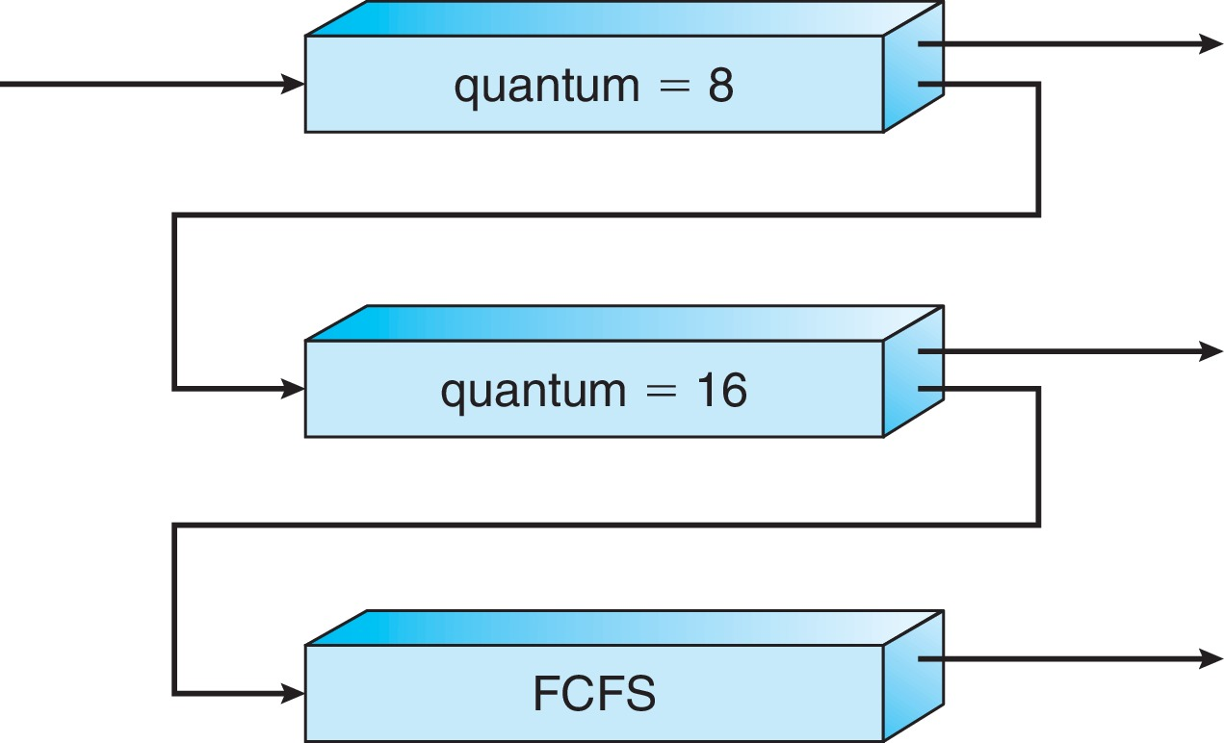
Example of Multilevel Feedback Queue
Three queues:
Q₀ – RR with time quantum 8 milliseconds
Q₁ – RR time quantum 16 milliseconds
Q₂ – FCFS
Scheduling
A new process enters queue Q₀ which is served in RR
When it gains CPU, the process receives 8ms
If it does not finish in 8ms, the process is moved to queue Q₁
At Q₁ job is again served in RR and receives 16 additional milliseconds
If it still does not complete, it is preempted and moved to queue Q₂

Slide 41
*5.4 Multiple-Processor Scheduling
CPU scheduling more complex when multiple CPUs are available
Homogeneous processors within a multiprocessor system
Asymmetric multiprocessing(AMP) – only one processor accesses the system data structures, reducing the need for data sharing, The other processors execute only user code.
symmetric multiprocessing (SMP) - each processor is self-scheduling. All processes may be in a common ready queue, or each processor may have its own private queue of ready processes. Regardless, scheduling proceeds by having the scheduler for each processor examine the ready queue and select a process to execute.

Slide 42
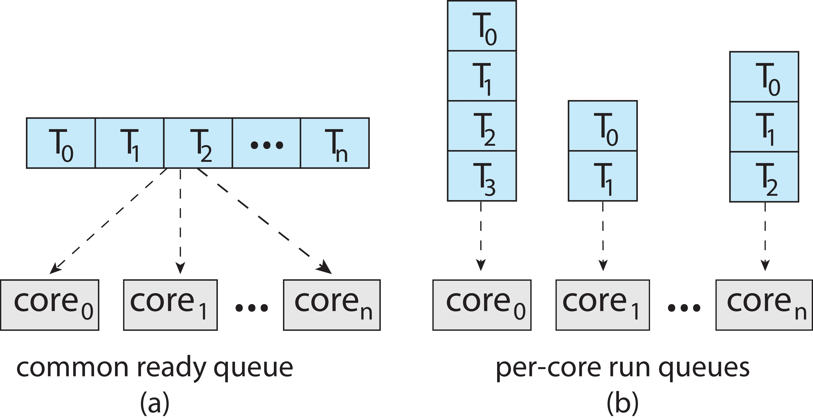
Multiple-Processor Scheduling
Symmetric multiprocessing (SMP) is where each processor is self scheduling.
All threads may be in a common ready queue (a)
Each processor may have its own private queue of threads (b)

Slide 43
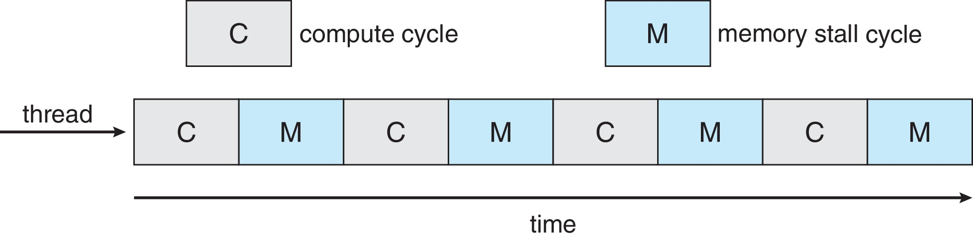
Multicore Processors
Recent trend to place multiple processor cores on same physical chip
Faster and consumes less power
Multiple threads per core also growing
Takes advantage of memory stall to make progress on another thread while memory retrieve happens
Figure

Slide 44
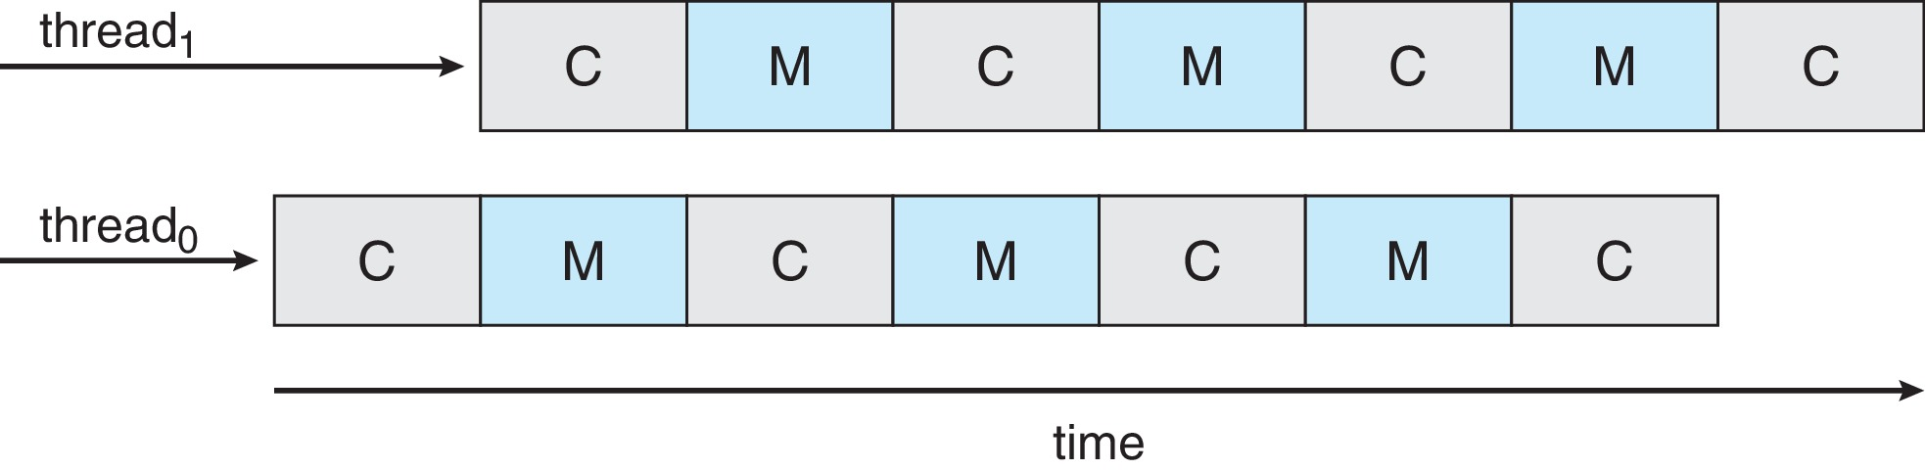
Multithreaded Multicore System
Each core has > 1 hardware threads.
If one thread has a memory stall, switch to another thread!
Figure

Slide 45
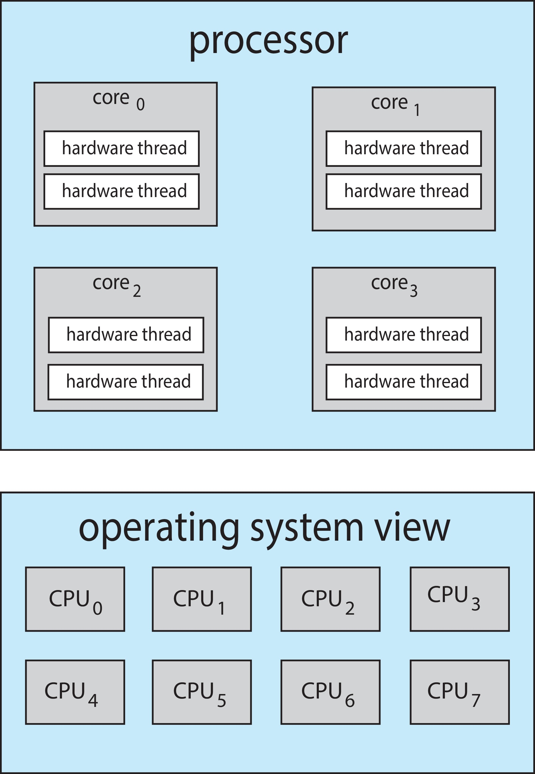
Multithreaded Multicore System
Chip-multithreading (CMT) assigns each core multiple hardware threads. (Intel refers to this as hyperthreading.)
On a quad-core system with 2 hardware threads per core, the operating system sees 8 logical processors.

Slide 46
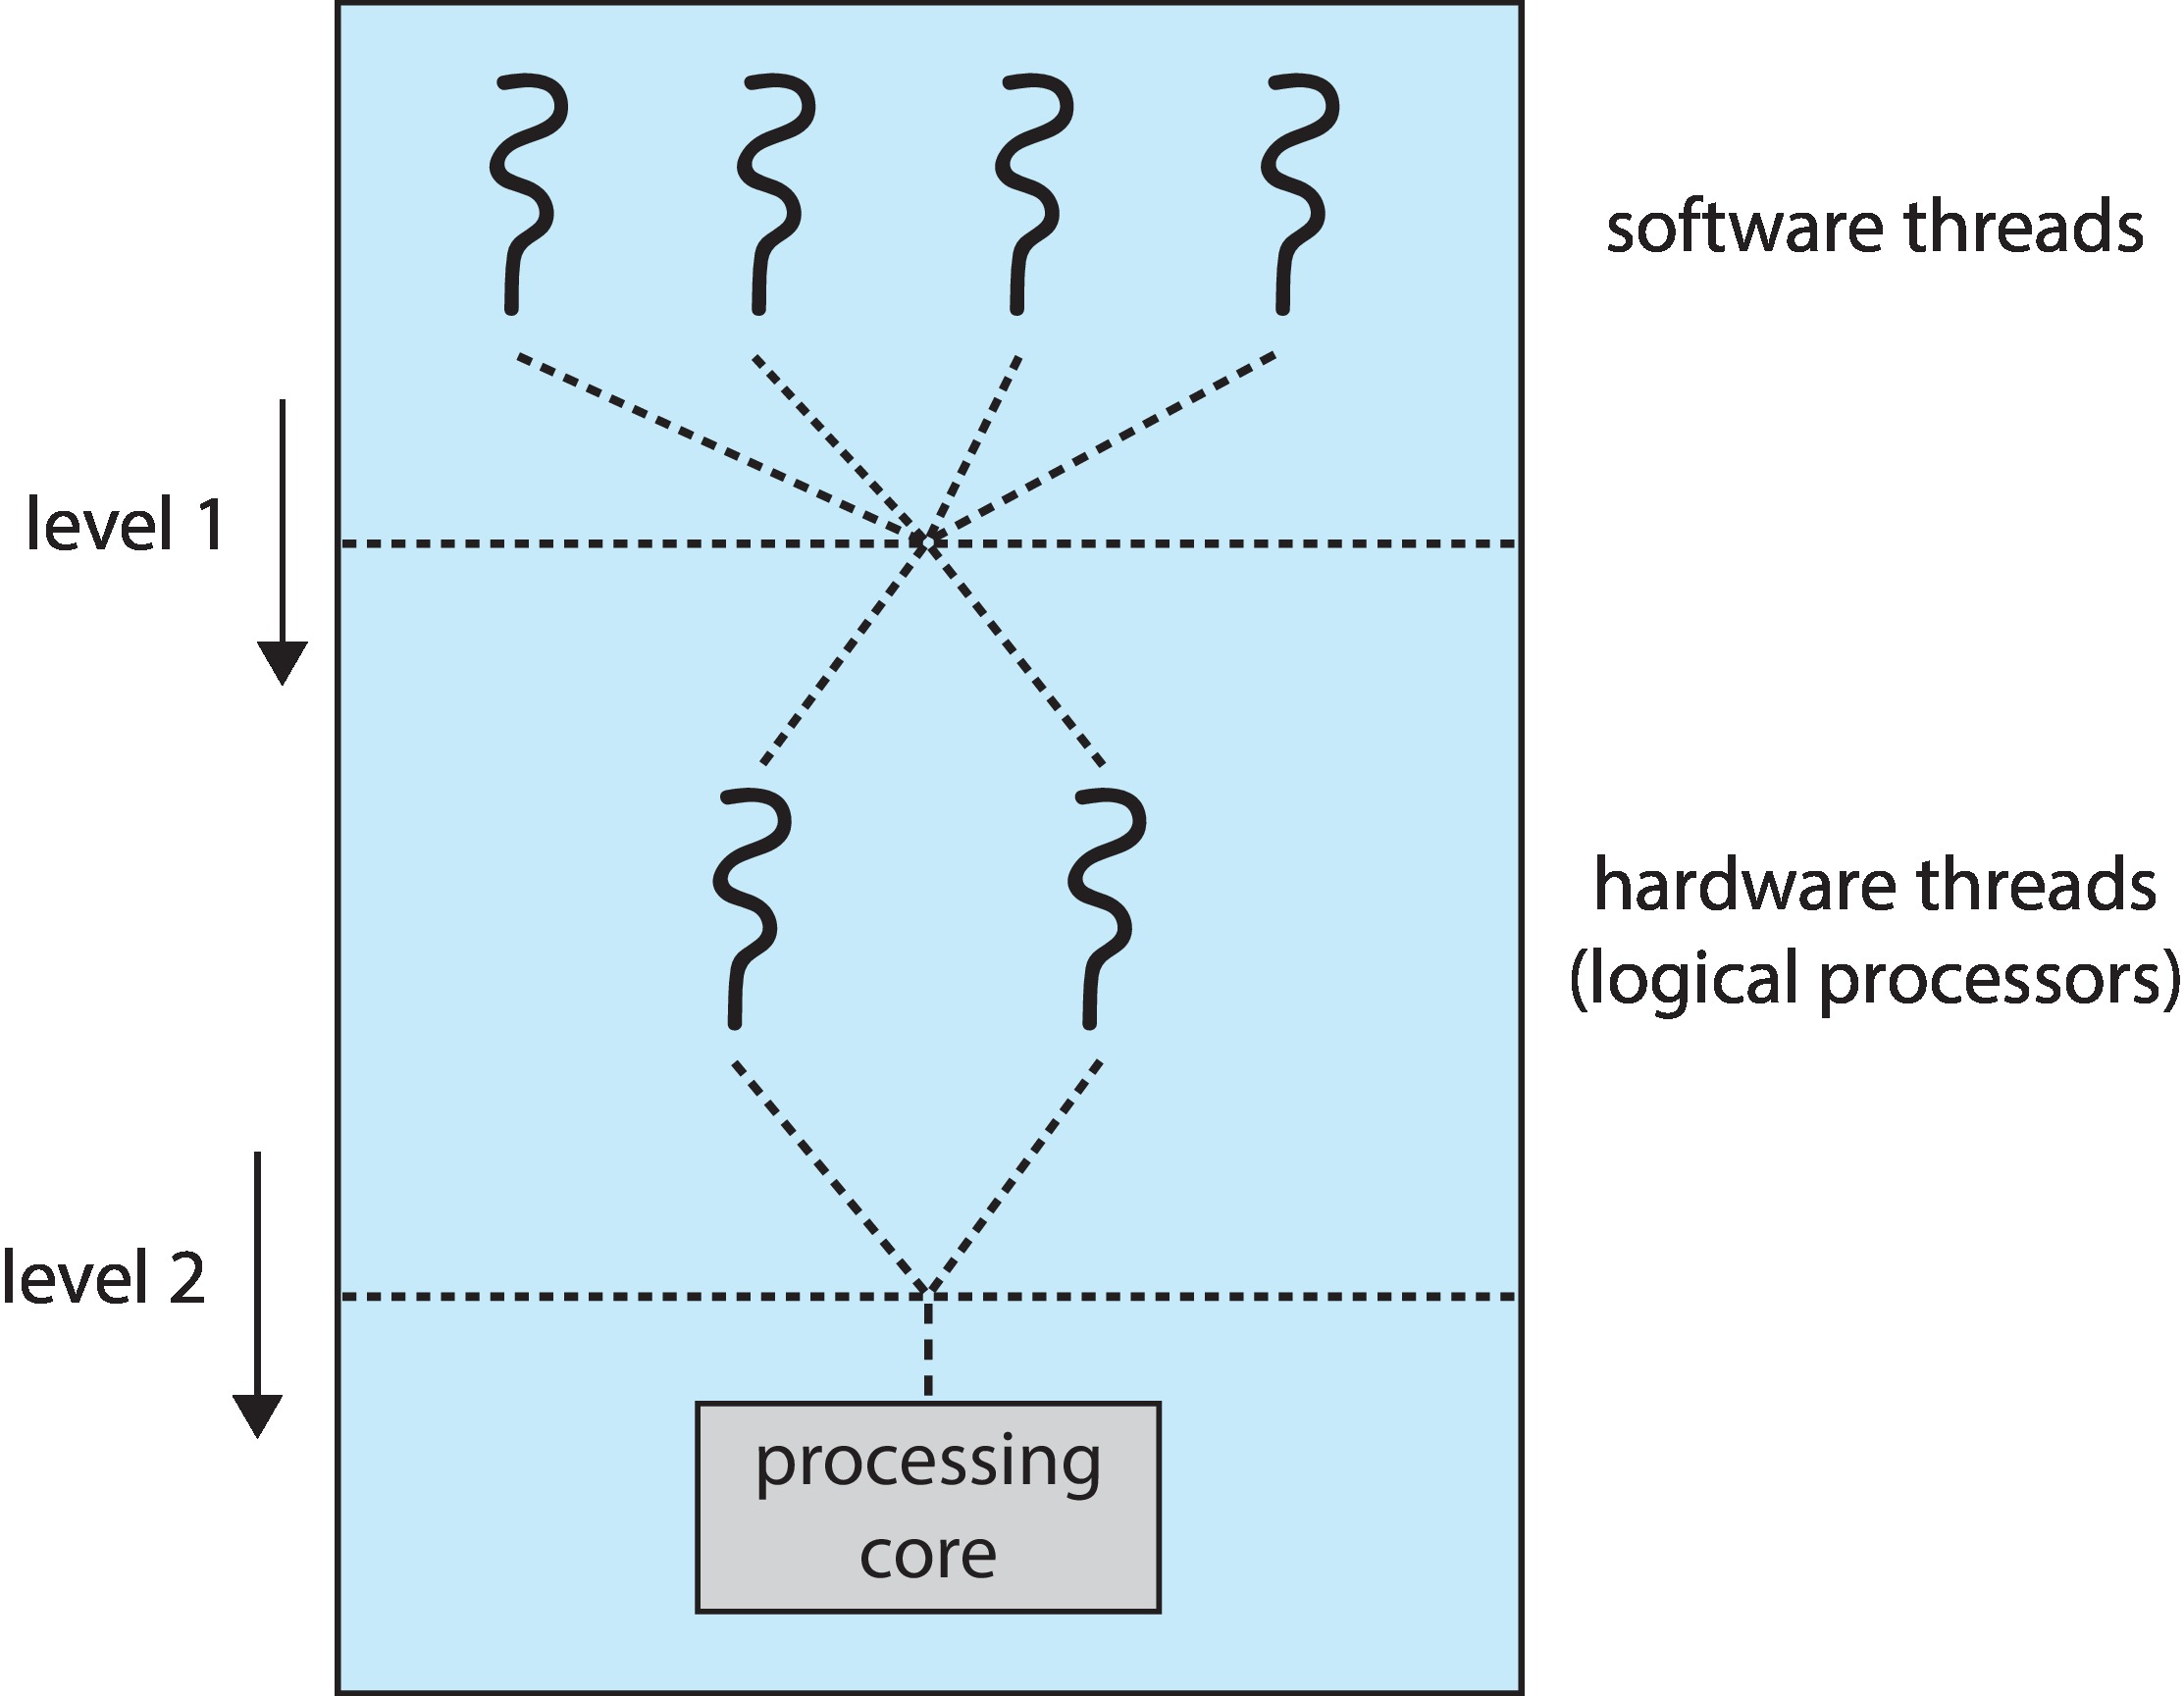
Multithreaded Multicore System
Two levels of scheduling:
The operating system deciding which software thread to run on a logical CPU
How each core decides which hardware thread to run on the physical core.

Slide 47
Multiple-Processor Scheduling – Load Balancing
If SMP, need to keep all CPUs loaded for efficiency
Load balancing attempts to keep workload evenly distributed
Push migration – periodic task checks load on each processor, and if found pushes task from overloaded CPU to other CPUs
Pull migration – idle processors pulls waiting task from busy processor

Slide 48
Multiple-Processor Scheduling – Processor Affinity
When a thread has been running on one processor, the cache contents of that processor stores the memory accesses by that thread.
We refer to this as a thread having affinity for a processor (i.e., “processor affinity”，处理器亲和性)
Load balancing may affect processor affinity as a thread may be moved from one processor to another to balance loads, yet that thread loses the contents of what it had in the cache of the processor it was moved off of.
Soft affinity – the operating system attempts to keep a thread running on the same processor, but no guarantees.
Hard affinity – allows a process to specify a set of processors it may run on.

Slide 49
NUMA and CPU Scheduling
If the operating system is NUMA-aware(非统一内存访问感知), it will assign memory closes to the CPU the thread is running on.

Slide 50
*5.5 Thread Scheduling
Distinction between user-level and kernel-level threads
When threads supported, threads scheduled, not processes
Many-to-one and many-to-many models, thread library schedules user-level threads to run on LWP
Known as process-contention scope (PCS) since scheduling competition is within the process
Typically done via priority set by programmer
Kernel thread scheduled onto available CPU is system-contention scope (SCS) – competition among all threads in system

Slide 51
Pthread Scheduling API
#include <pthread.h>
#include <stdio.h>
#define NUM THREADS 5
int main(int argc, char *argv[])
{
int i;
pthread_t tid[NUM THREADS];
pthread_attr_t attr;
/* get the default attributes */
pthread_attr_init(&attr);
/* set the scheduling algorithm to PROCESS or SYSTEM */
pthread_attr_setscope(&attr, PTHREAD SCOPE SYSTEM);
/* set the scheduling policy - FIFO, RT, or OTHER */
pthread_attr_setschedpolicy(&attr, SCHED OTHER);
/* create the threads */
for (i = 0; i < NUM THREADS; i++)
pthread_create(&tid[i], &attr, runner, NULL);

Slide 52
Pthread Scheduling API
/* now join on each thread */
for (i = 0; i < NUM THREADS; i++)
pthread_join(tid[i], NULL);
}
/* Each thread will begin control in this function */
void *runner(void *param)
{
printf("I am a thread\n");
pthread_exit(0);
}

Slide 53
*5.6 Operating System Examples
Solaris scheduling
Windows scheduling
Linux scheduling

Slide 54
Solaris
Priority-based scheduling
Six classes available
Time sharing (default) (TS)
Interactive (IA)
Real time (RT)
System (SYS)
Fair Share (FSS)
Fixed priority (FP)
Given thread can be in one class at a time
Each class has its own scheduling algorithm
Time sharing is multi-level feedback queue
Loadable table configurable by sysadmin

Slide 55
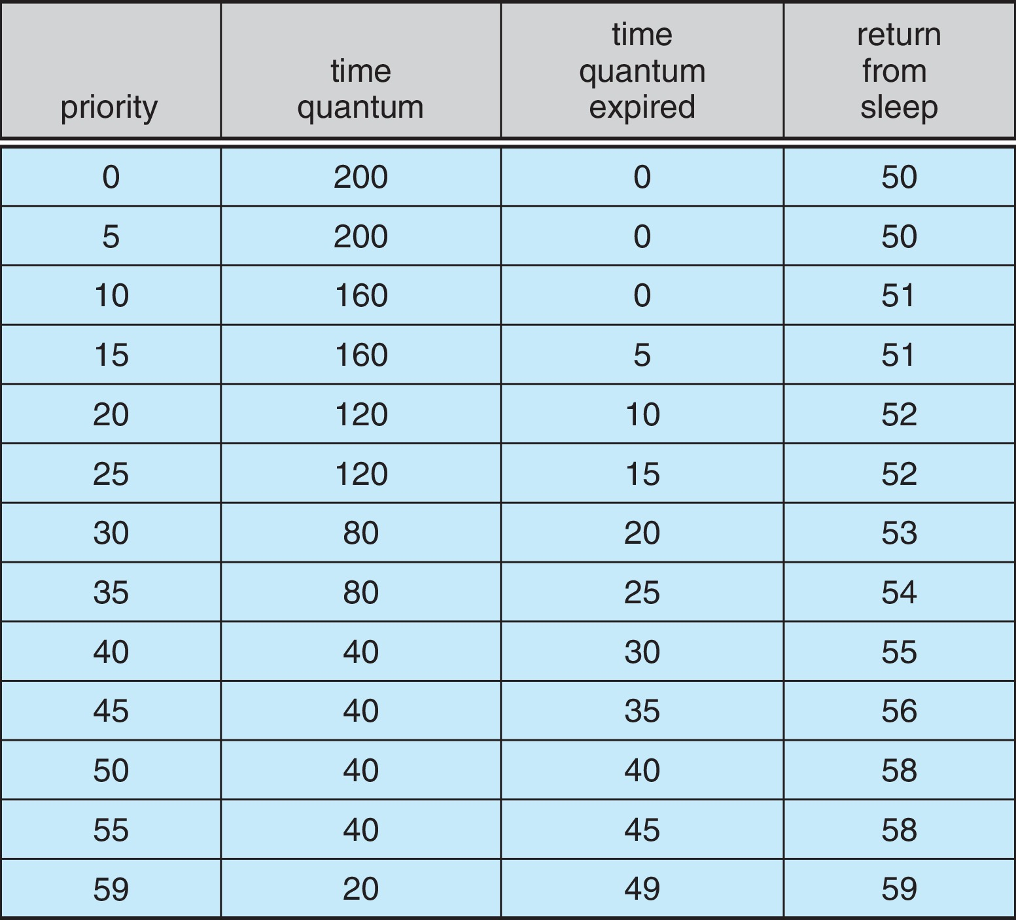
Solaris Dispatch Table

Slide 56
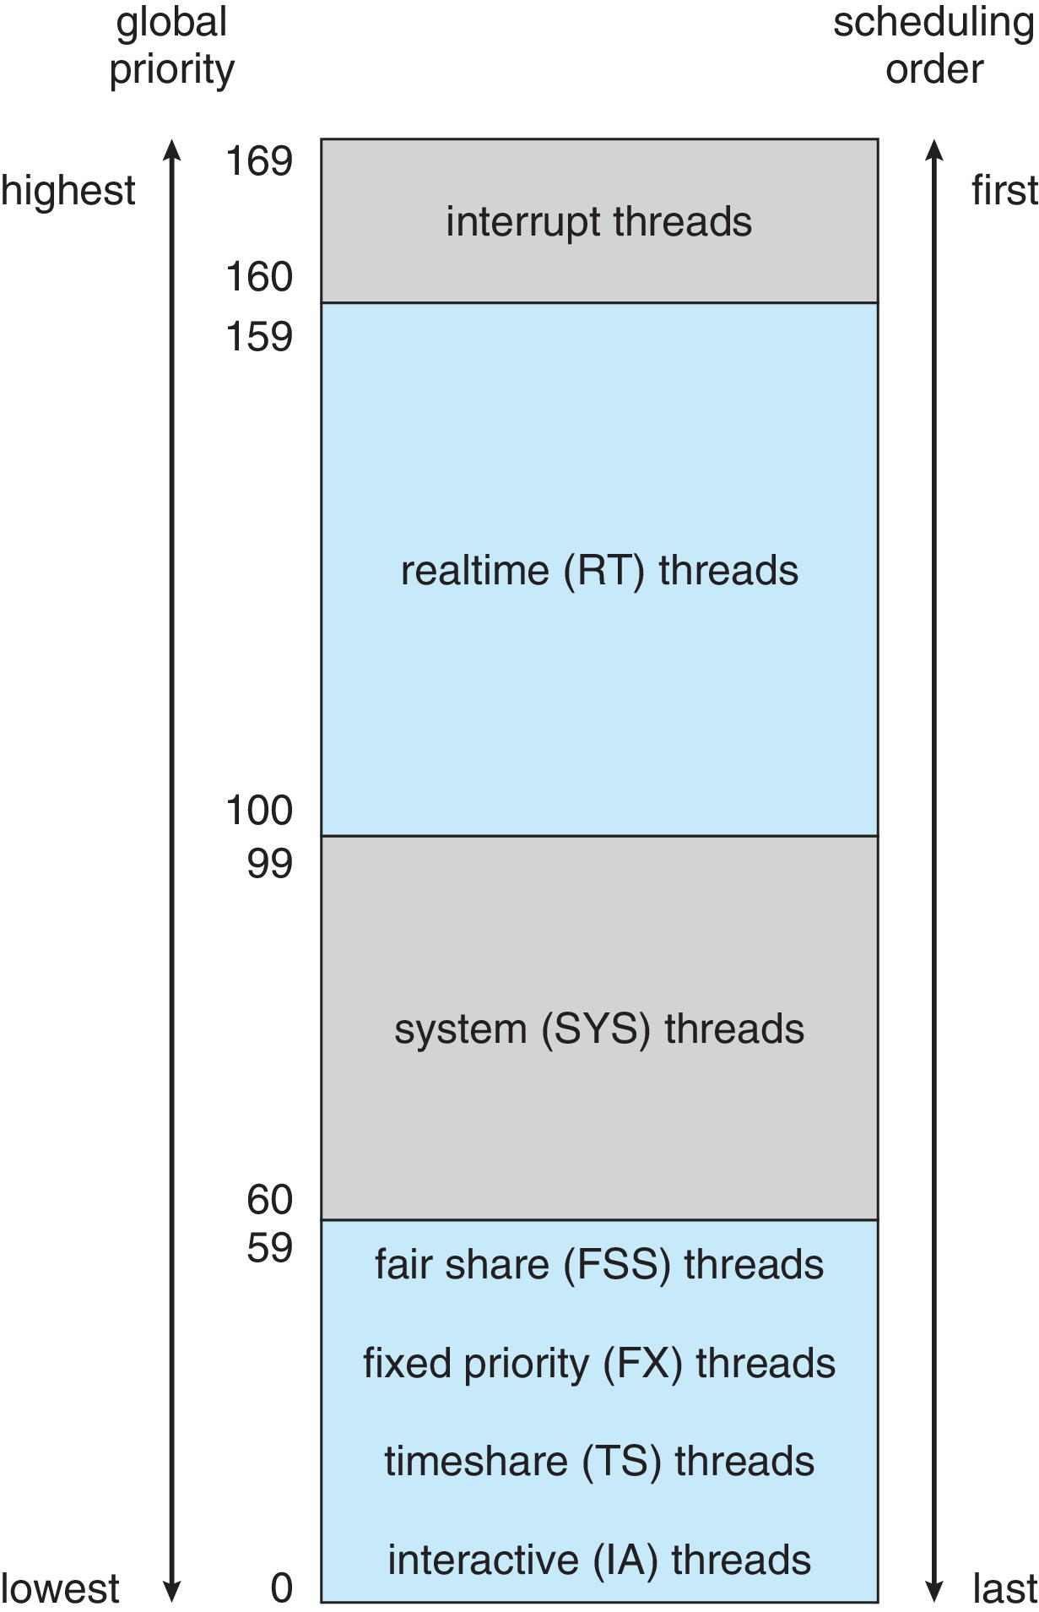
Solaris Scheduling

Slide 57
Solaris Scheduling (Cont.)
Scheduler converts class-specific priorities into a per-thread global priority
Thread with highest priority runs next
Runs until (1) blocks, (2) uses time slice, (3) preempted by higher-priority thread
Multiple threads at same priority selected via RR

Slide 58
Windows Scheduling
Windows uses priority-based preemptive scheduling
Highest-priority thread runs next
Dispatcher is scheduler
Thread runs until (1) blocks, (2) uses time slice, (3) preempted by higher-priority thread
Real-time threads can preempt non-real-time
32-level priority scheme
Variable class is 1-15, real-time class is 16-31
Priority 0 is memory-management thread
Queue for each priority
If no run-able thread, runs idle thread

Slide 59
Windows Priority Classes
Win32 API identifies several priority classes to which a process can belong
REALTIME_PRIORITY_CLASS, HIGH_PRIORITY_CLASS, ABOVE_NORMAL_PRIORITY_CLASS,NORMAL_PRIORITY_CLASS, BELOW_NORMAL_PRIORITY_CLASS, IDLE_PRIORITY_CLASS
All are variable except REALTIME
A thread within a given priority class has a relative priority
TIME_CRITICAL, HIGHEST, ABOVE_NORMAL, NORMAL, BELOW_NORMAL, LOWEST, IDLE
Priority class and relative priority combine to give numeric priority
Base priority is NORMAL within the class
If quantum expires, priority lowered, but never below base

Slide 60
Windows Priority Classes (Cont.)
If wait occurs, priority boosted depending on what was waited for
Foreground window given 3x priority boost
Windows 7 added user-mode scheduling (UMS)
Applications create and manage threads independent of kernel
For large number of threads, much more efficient
UMS schedulers come from programming language libraries like C++ Concurrent Runtime (ConcRT) framework

Slide 61
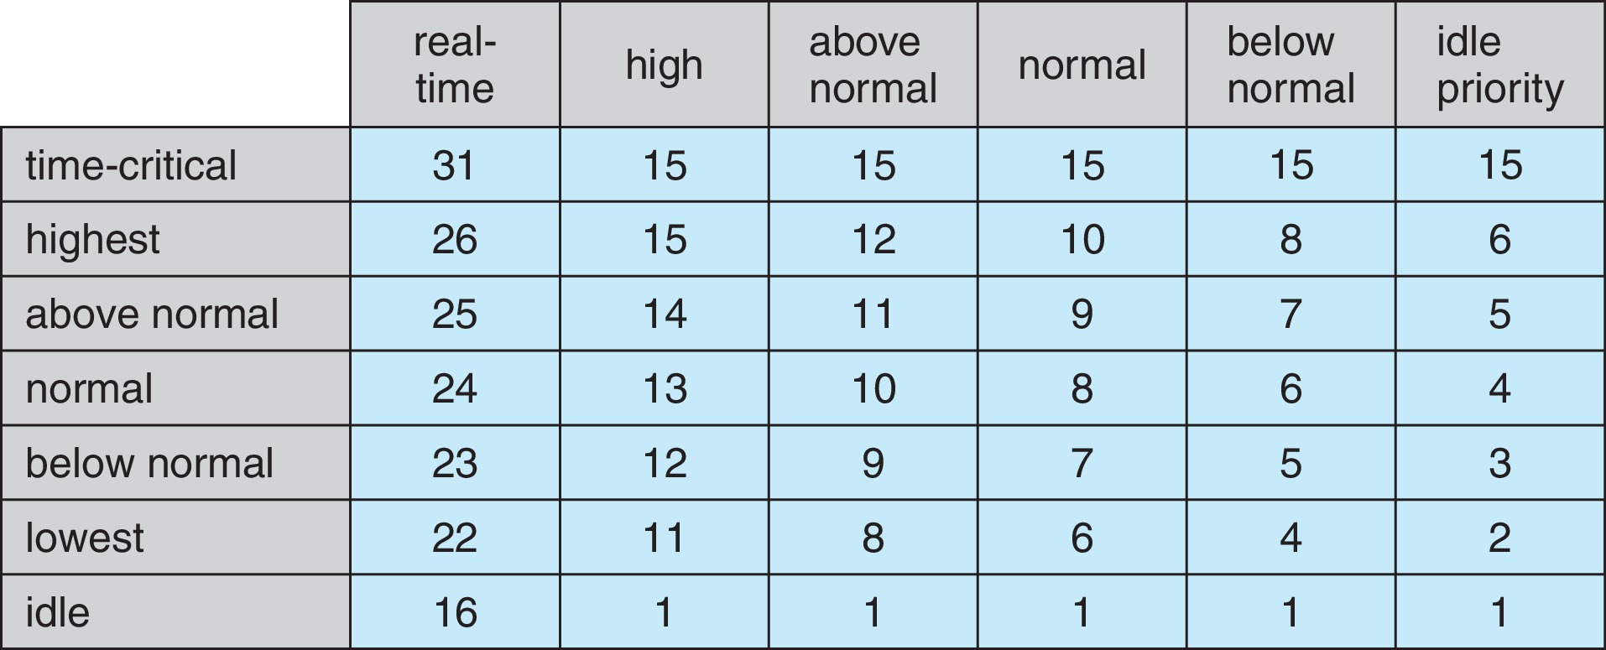
Windows Priorities

Slide 62
Linux Scheduling Through Version 2.5
Prior to kernel version 2.5, ran variation of standard UNIX scheduling algorithm
Version 2.5 moved to constant order O(1) scheduling time
Preemptive, priority based
Two priority ranges: time-sharing and real-time
Real-time range from 0 to 99 and nice value from 100 to 140
Map into global priority with numerically lower values indicating higher priority
Higher priority gets larger q
Task run-able as long as time left in time slice (active)
If no time left (expired), not run-able until all other tasks use their slices
All run-able tasks tracked in per-CPU runqueue data structure
Two priority arrays (active, expired)
Tasks indexed by priority
When no more active, arrays are exchanged
Worked well, but poor response times for interactive processes

Slide 63
Linux Scheduling in Version 2.6.23 +
Completely Fair Scheduler (CFS)
Scheduling classes
Each has specific priority
Scheduler picks highest priority task in highest scheduling class
Rather than quantum based on fixed time allotments, based on proportion of CPU time
Two scheduling classes included, others can be added
default
real-time

Slide 64
Linux Scheduling in Version 2.6.23 + (Cont.)
Quantum calculated based on nice value from -20 to +19
Lower value is higher priority
Calculates target latency – interval of time during which task should run at least once
Target latency can increase if say number of active tasks increases
CFS scheduler maintains per task virtual run time in variable vruntime
Associated with decay factor based on priority of task – lower priority is higher decay rate
Normal default priority yields virtual run time = actual run time
To decide next task to run, scheduler picks task with lowest virtual run time

Slide 65
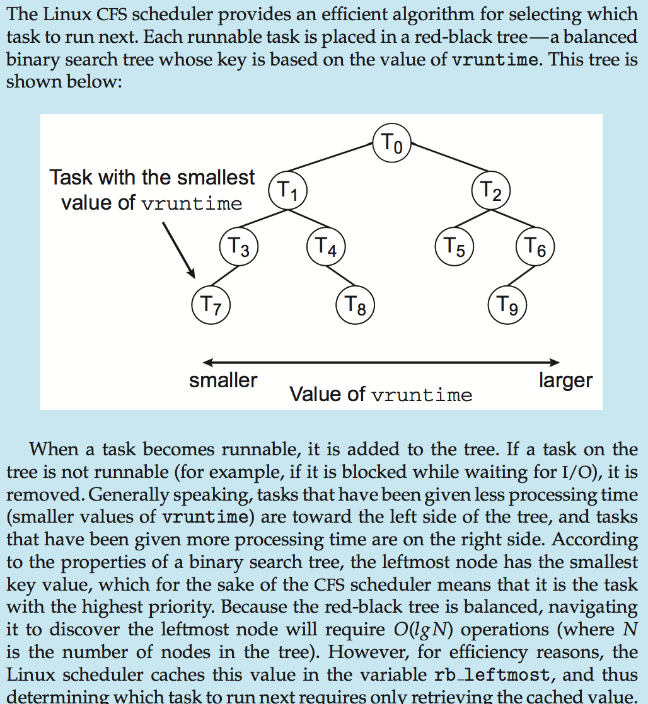
CFS Performance

Slide 66
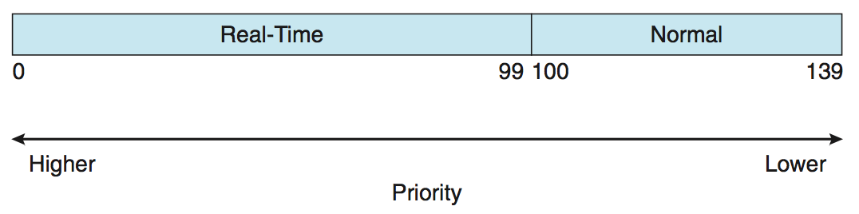
Linux Scheduling (Cont.)
Real-time scheduling according to POSIX.1b
Real-time tasks have static priorities
Real-time plus normal map into global priority scheme
Nice value of -20 maps to global priority 100
Nice value of +19 maps to priority 139

Slide 67
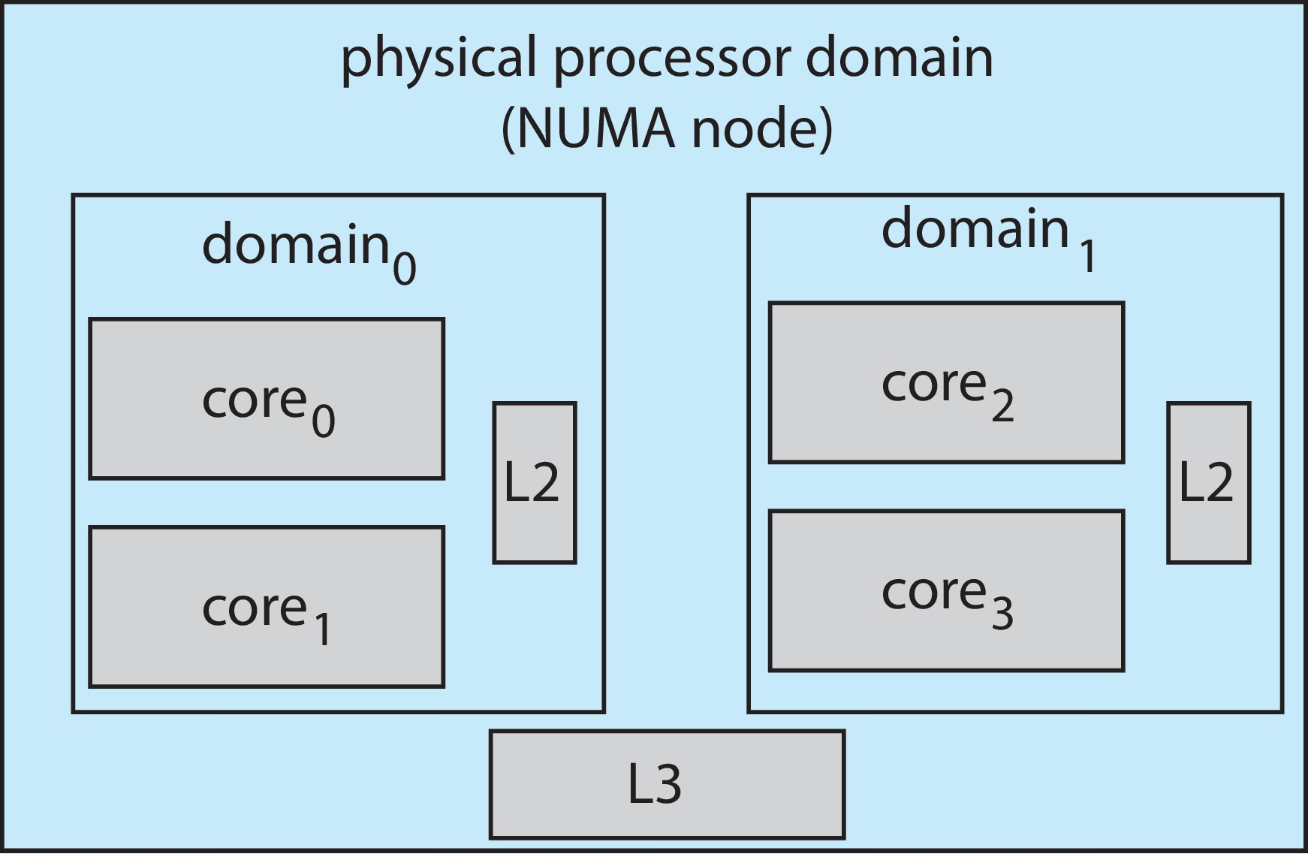
Linux Scheduling (Cont.)
Linux supports load balancing, but is also NUMA-aware.
Scheduling domain is a set of CPU cores that can be balanced against one another.
Domains are organized by what they share (i.e., cache memory.) Goal is to keep threads from migrating between domains.

Slide 68
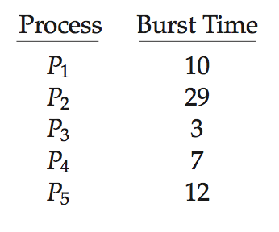
5.7 Algorithm Evaluation(算法评估)
How to select CPU-scheduling algorithm for an OS?
Determine criteria, then evaluate algorithms
Deterministic modeling
Type of analytic evaluation
Takes a particular predetermined workload and defines the performance of each algorithm for that workload
Consider 5 processes arriving at time 0:

Slide 69
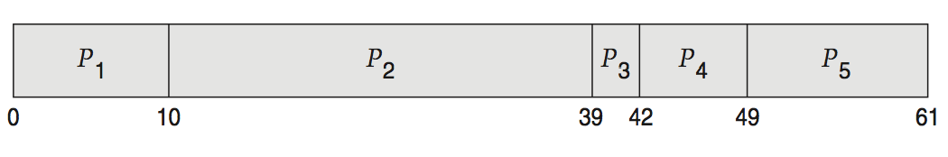
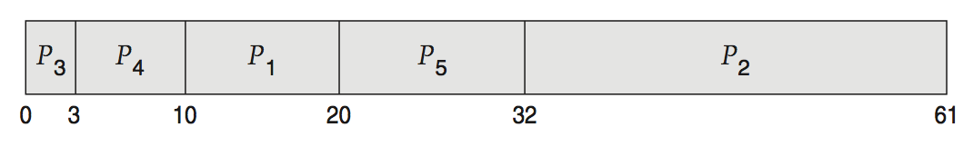
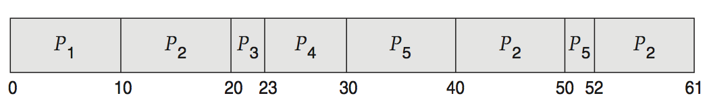
Deterministic Evaluation
For each algorithm, calculate minimum average waiting time
Simple and fast, but requires exact numbers for input, applies only to those inputs
FCFS is 28ms:
Non-preemptive SFJ is 13ms:
RR is 23ms:

Slide 70
Queueing Models
Describes the arrival of processes, and CPU and I/O bursts probabilistically
Commonly exponential, and described by mean
Computes average throughput, utilization, waiting time, etc.
Computer system described as network of servers, each with queue of waiting processes
Knowing arrival rates and service rates
Computes utilization, average queue length, average wait time, etc.

Slide 71
Little’s Formula
n = average queue length
W = average waiting time in queue
λ = average arrival rate into queue
Little’s law – in steady state, processes leaving queue must equal processes arriving, thus: n = λ x W
Valid for any scheduling algorithm and arrival distribution
For example, if on average 7 processes arrive per second, and normally 14 processes in queue, then average wait time per process = 2 seconds

Slide 72
Simulations
Queueing models limited
Simulations more accurate
Programmed model of computer system
Clock is a variable
Gather statistics indicating algorithm performance
Data to drive simulation gathered via
Random number generator according to probabilities
Distributions defined mathematically or empirically
Trace tapes record sequences of real events in real systems

Slide 73
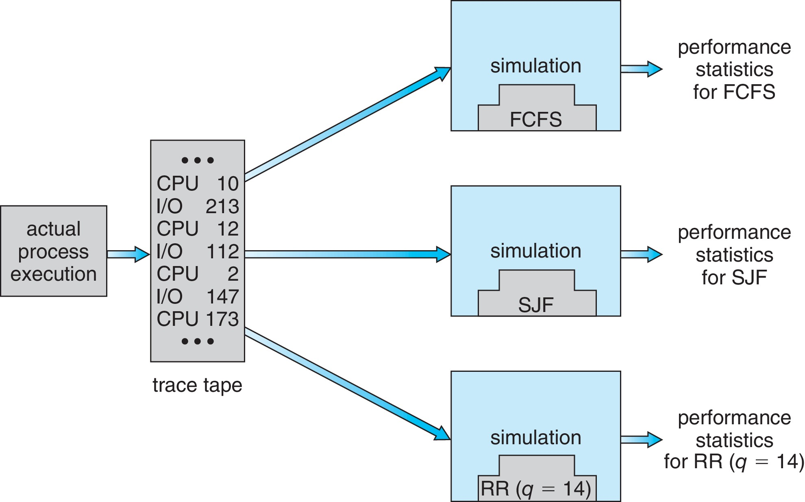
Evaluation of CPU Schedulers by Simulation

Slide 74
Implementation
Even simulations have limited accuracy
Just implement new scheduler and test in real systems
High cost, high risk
Environments vary
Most flexible schedulers can be modified per-site or per-system
Or APIs to modify priorities
But again environments vary

Slide 75
Summary 1/6
CPU scheduling is the task of selecting a waiting process from the ready queue and allocating the CPU to it. The CPU is allocated to the selected process by the dispatcher.
Scheduling algorithms may be either preemptive (where the CPU can be taken away from a process) or nonpreemptive (where a process must voluntarily relinquish control of the CPU). Almost all modern operating systems are preemptive.
Scheduling algorithms can be evaluated according to the following five criteria: (1) CPU utilization, (2) throughput, (3) turnaround time, (4)waiting time, and (5) response time.

Slide 76
Summary 2/6
First-come, first-served (FCFS) scheduling is the simplest scheduling algorithm, but it can cause short processes to wait for very long processes.
Shortest-job-first (SJF) scheduling is provably optimal, providing the shortest average waiting time. Implementing SJF scheduling is difficult, however, because predicting the length of the next CPU burst is difficult. The SJF algorithm can be either preemptive or nonpreemptive, preemptive SJF scheduling is sometimes called shortest-remaining-time-firs scheduling.

Slide 77
Summary 3/6
Highest response ratio next (HRRN) scheduling is a non-preemptive discipline, similar to shortest job next (SJN), in which the priority of each job is dependent on its estimated run time, and also the amount of time it has spent waiting. Jobs gain higher priority the longer they wait, which prevents indefinite postponement (process starvation).
Round-robin (RR) scheduling allocates the CPU to each process for a time quantum. If the process does not relinquish the CPU before its time quantum expires, the process is preempted, and another process is scheduled to run for a time quantum.

Slide 78
Summary 4/6
Priority scheduling assigns each process a priority, and the CPU is allocated to the process with the highest priority. Processes with the same priority can be scheduled in FCFS order or using RR scheduling.
Multilevel queue scheduling partitions processes into several separate queues arranged by priority, and the scheduler executes the processes in the highest-priority queue. Different scheduling algorithms may be used in each queue.
Multilevel feedback queues are similar to multilevel queues, except that a process may migrate between different queues.

Slide 79
Summary 5/6
Multicore processors place one or more CPUs on the same physical chip, and each CPU may have more than one hardware thread. From the perspective of the operating system, each hardware thread appears to be a logical CPU.
Load balancing on multicore systems equalizes loads between CPU cores, although migrating threads between cores to balance loads may invalidate cache contents and therefore may increase memory access times.
Soft real-time scheduling gives priority to real-time tasks over non-realtime tasks. Hard real-time scheduling provides timing guarantees for realtime tasks.

Slide 80
Summary 6/6
Linux uses the completely fair scheduler (CFS), which assigns a proportion of CPU processing time to each task. The proportion is based on the virtual runtime (vruntime) value associated with each task.
Windows scheduling uses a preemptive, 32-level priority scheme to determine the order of thread scheduling.
Solaris identifies six unique scheduling classes that are mapped to a global priority. CPU-intensive threads are generally assigned lower priorities (and longer time quantums), and I/O-bound threads are usually assigned higher priorities (with shorter time quantums.)
Modeling and simulations can be used to evaluate a CPU scheduling algorithm.

Slide 81
End of Chapter 5: CPU Scheduling

